Slide 1
“Mauri Wai, Mauri Whenua, Mauri Tangata, Mauri Ora...
Tihei Mauri Ora!
~ Te Roopu Taiao o Ngāti Whakatere ~

Slide 2
Pepehā
Ko Tainui te Waka
Ko Hoturoa te Tangata
Ko Tararua ngā pae maunga
Ko Te Ao Kapaarangi te tihi
Ko Manawatu te Awa
Ko Ngāti Raukawa ki te tonga te Iwi
Ko Ngāti Whakatere te Hapū
Ko Whakawehi te Marae.
Ko Turongo te Whare Karakia
Ko Poutu te Whare Tupuna
Ko Mahi Tamariki te Whare Iti
Ko Hinekēkehu te Whare Kai

Slide 3
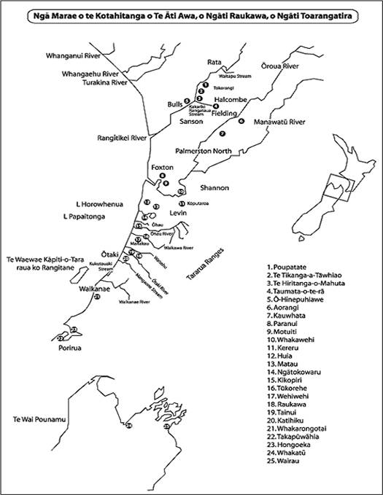
Te Rohe o Ngāti Raukawa ki te Tonga

Slide 4
Te Kete Taiao Rauemi
Ngāti Whakatere Environmental Toolkit
KEY CONCEPTS & VALUES
Poutu Pa Well-being
Ahi Kaaroa
Ka Tipu Ake Tātou
Papatūānuku
Technical / Engineering Tool
Legal Tool (Legislation)
Iwi //Whānau
PPWM
MAM
LT
COM
KTATM
TT
PM
Environment
Papatuanuku

Slide 5
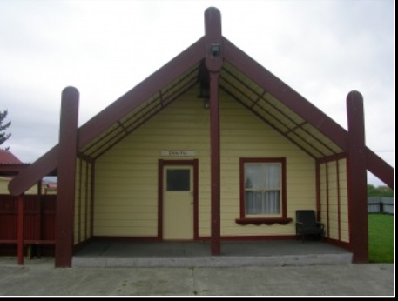
Poutu Pa Well-being Model
These well-being concepts have been passed down from generation to generation from our kaumātua and leaders of our whānau, hapū and iwi. TRTONW have used this concept model in Commissioner’s hearings, HDC Consultation, Community hui, Environment hearings and to describe the value and inter-connectedness we have with Papatūānuku. An indepth explanation for the Poutu Pa Well-being model was given as evidence at an Environment hearing in 2014 by Hēmi Te Peeti, Milton Rauhihi and Robert Ketu, for the Shannon Wastewater Treatment Plant.
Ngā Pou
Atua
Wairua
Hinengaro
Tīnana
Whānau

Slide 6
Mana Whenua / Ahi Kaaroa
Primary Governance over our ancestral lands, waterways etc.
Co-Management
Partnership
Participation
Protection
Influencing decision making on Local, Regional, National and International levels
International
National
Regional
Local

Slide 7
Ka Tipu Ake Tātou
Cultural Sustainability
Environment
Culture
Social
Economic

Slide 8
How does this affect the Kaitiaki role of Ngāti Whakatere?

Slide 9
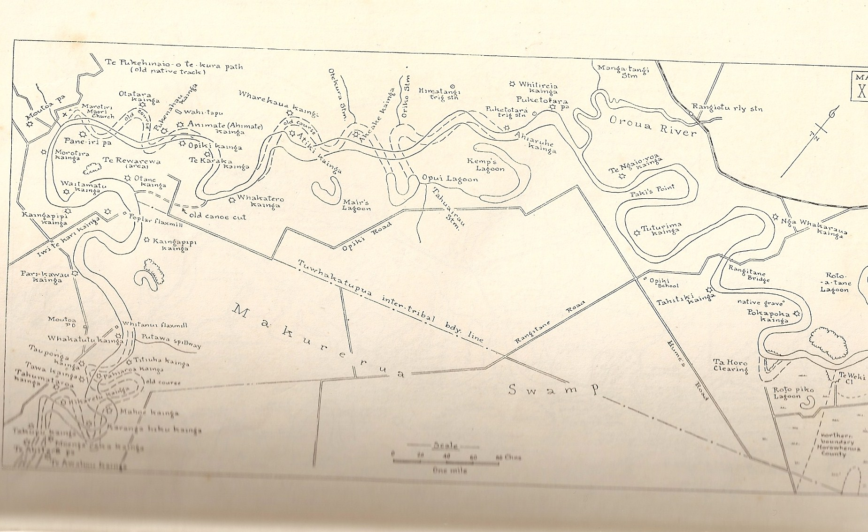
Relationship of the Manawatu River
Ngāti Whakatere
Ngati Takihiku
Ngāti Hinemata
Ngāti Ngārongo
Ngāti Tūranga
Ngāti Rākau
Ngāti Te Au
Ngāti Huia
Ngāti Kikopiri
Tu Whakatipua

Slide 10
Effects Assessd
Principles Treaty of Waitangi
RMA I991
Ngāti Whakatere Cultural Values
Archaeological Report (Incomplete)
Cultural Impact Assessments (Incomplete)
Eketahuna WWTP

Slide 11
Identified Cultural Values
Ancestral land | Water | Waahi Tapu | Flora and Fauna | Other Taonga
Tararua Rangers Te Maire Whakawehi Marae Moutoa Tu Whakatipua Oroua River Paiaka Whirokino Matakarapa Te Rerengaohau Kukutauaki 7E Te Kapahaka | Rangitikei River Oroua River Manawatu River Tokomaru River Otuaru River Customary fishing Fish migration Spiritual ceremonies Lagoon Lakes Wetland Subterranean waters Natural streams Man made rivers and streams Te Moana Ecosystems | Waahi Tapu Waahi Tupuna Sand Dunes Marae Whare Tupuna Whare Karakia Battle sites Urupa Agriculture Matauranga Maori | Native Trees Flora Fauna Flax Plant Pingao Raupo Ecosystems | Peketahi and Papangaio Ihakara Drain Lizard Kotuku,GodwittNative fresh species RAMSAR Ecosystems
Mauri Wai, Mauri Whenua, Mauri Tangata
Mauri Ora....
Tīhei Mauri Ora!

Slide 12
Principles of the Treaty of Waitangi
Taking into account the Treaty of Waitangi principles | Are these impacted by the proposed Application—and if so, how?
The obligation to act reasonably, in the utmost good faith and in a manner that is consistent with partnership. | The obligation of partnership is expressed in the principle of Kanohi ki te Kanohi (Face to face). Its foundation is built on relationships, integrity, trustworthiness, mutual understanding and equitable power sharing. The ability to act in reasonably good faith is not shared by all parties at this point in time. Further relationship building is necessary.
The requirement for all decisions to be made on an informed basis. | Inclusion at the earliest part of decision making with Tangata Whenua is essential. The proposal for the Shannon wastewater has serious implications for Ngati Whakatere and neighbouring Hapu residing downstream of the Manawatu River. Ongoing consultation and Information sharing is essential to Iwi and Hapu participating in decision making.
Obligation to actively protect Māori interests. | The further investigation of a missing archaeological report for Valvaleen Farrn on Waahi Tapu, Urupa and sites of significance to Tangata Whenua indicates that the SWWTP was granted on lack of legislation due process. Note: Further an Investigation needs to be reported.
The Crown’s obligation to not unduly impede or diminish its capacity to provide redress where a valid Treaty grievance is established. | Note: Ngāti Whakatere is currently in the process of pre-negotiation settlement of the Treaty of Waitangi.

Slide 13
Impacts and Effects for Ngāti Whakatere
Moderate and significant effects |  | Positive (+) | Adverse (-) High
Environmental | Significant | Horowhenua District Council will need to manage and protect all identified areas. | The intrinsic value of Māori and how we connect to the bio-physical worlds is highly affected.
Cultural | Significant | Horowhenua District Council will need to engage with Ngati Whakatere to increase understanding of Ngati Whakatere cultural values. | The cultural value of Ngati Whakatere and how we relate to Papatuanuku is expressed in part in the Te Kete Taiao Rauemi model.
Social | Significant | Hazardous substances in contamination, pollution and toxic chemicals need mitigation for cattle grazing, air discharge over and river runoff. | The loss of recreational values to Ngati Whakatere is demonstrated by the degradation of water quality and quantity of sustaining ecosystems, land and sites of significance.
Economics | Significant | The opportunity to find a cost effective alternative solution. | The economic cost to Ngati Whakatere needs to be further investigated or analysed through a economic assessment.
Relationships | Significant | To engage with Ngati Whakatere on all levels of decision-making. | The Kaitiaki role of Ngati Whakatere as Treaty partners, protectors, guardians, managers and stewards of resources has serious implications for Ngati Whakatere in respect of participation.
Treaty Principles | Significant | To engage in equitable power sharing. | The power sharing base of decision making regarding matters affecting Ngati Whakatere will need to be further addressed throughout this process.
Table 2: LEVELS OF RISK ASSESSED
Moderate or significant effects evaluating both positive and adverse elements.

Slide 14
KA TIPU AKE TĀTOU
100% discharged to land
We have set a precedence for all other Councils
We are sitting at the decision-making table with Ministers, Mayor's and CEO's
Influencing quantitive change in environmental court direction at hearings especially how counsellors deal with Hapū

Slide 15
KA TIPU AKE TĀTOU
Recognition of the Manawhenua of Ngāti Whakatere
Influencing high-level technical alternative solutions. Soil, water, engineering

Slide 16
Desired Outcomes
Our two parties will work together to:
Consult (clarify) with each other on issues of significance which are likely to impact on environment's identified by Ngāti Whakatere
Develop opportunities that enable Ngāti Whakatere to actively share in what Tararua District Council is charged with administering
Ensure environmental outcomes are delivered in an agreed framework where Ngati Whakatere Values and Principles are embedded and Tararua District Council is present (Kanohi ki te kanohi)

Slide 17
Desired Outcomes
Develop and reflect into our communities a mutual commitment to environmental outcomes within the rohe of Ngāti Whakatere. Additionally each party shall ensure a commitment to approaching environmental management in a bi-cultural framework for projects agreed between parties
Ensure environmental outcomes are delivered in a framework where information and understanding of cross-cultural perspectives are freely shared.
Develop an Agreement of Partnership with a view that will form the long-term relationship between the Tararua District Council and Ngāti Whakatere.

